Slide 1
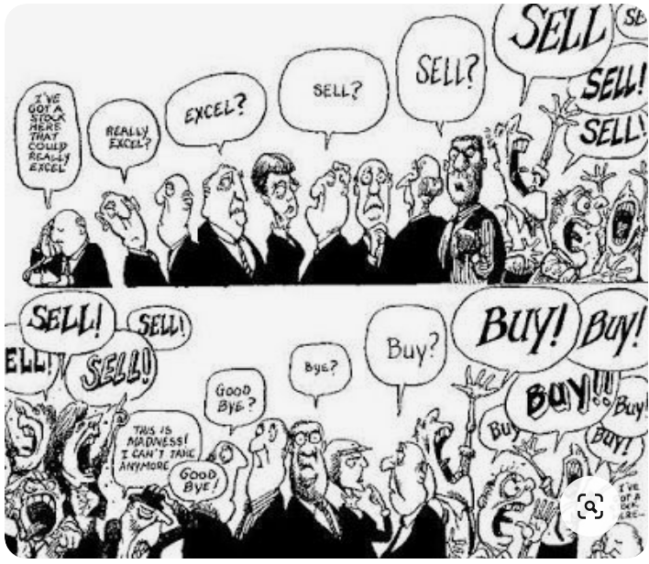
Cas Applied Data Science – October 7th 2021 Nasdaq composite price & macro variables
University of Bern
Sources: The economist

Slide 2
Project objectives & Data set description
Research objective:
The objective of this research is to examine the impacts of some macroeconomic factors on the stock market returns of the NASQAD composite index
Two models are conducted in this study:
The Ordinary Least Squared (OLS) to test the relationship between the macro variables and the NASDAQ composite index
The Granger Causality test to examine the relation between individual explanatory variables and the NASDAQ composite index (bidirectional).
Abstract:
Macroeconomic variables affect the performance of the stock market. Investors consider macroeconomic variables when they value stocks. Interest rates, unemployment, inflation and GDP are very important among these macroeconomic variables which are often used to explain stocks price performance. Several studies have been conducted to determine the relationship between the macroeconomic variable and stock prices in the past. We are going to look into some of these variables to see if we can conclude any relationship performance based on a linear regression-
We use 4 independent variables: GDP, CPI, US CPI, US Interest rates, US Unemployment rates and one dependent variables: Nasdaq composite price performance
Sources: Fed Saint Louis & Nasdaq

Slide 3
Data set description and methods
Date set description: The data set consists of 95 instances and 5 attributes
There are 4 independent variables:
-GDP: We use GGP in percent change from preceding Period, quarterly, Seasonally Adjusted Annual Rate.
-CPI (consumer price inflation): Growth Rate Same Period Previous Year, Monthly, Not Seasonally Adjusted.
-US Interest rates: Effective Federal Funds Rate, Percent, Monthly, Not Seasonally Adjusted.
-US Unemployment rate in Percent, Monthly, Seasonally Adjusted.
Dependent variable:
-Nasdaq composite index, which is a stock market index that includes almost all stocks listed on the Nasdaq stock exchange. The index is heavily towards Information Technology / Communication sectors
Sources: Fed Saint Louis & Nasdaq
Simplified data flow
Fed Saint-Louis timeseries for independent variables
Loading the data into Jupyter (csv or api)
Test for stationarityttthen first / second difference
OLS and Grander causality test
Cleaning, merging & data analyles
Nasdaq time series for dependent variable

Slide 4
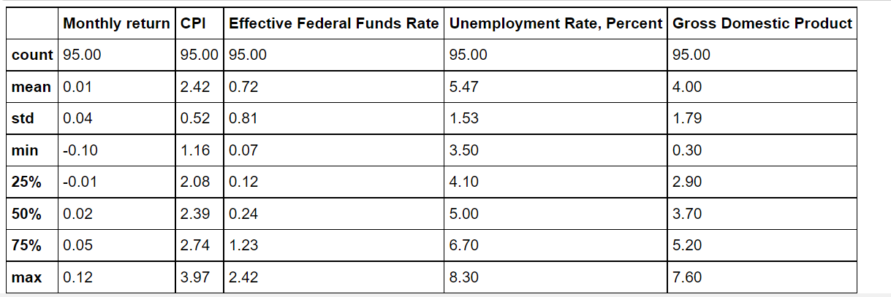
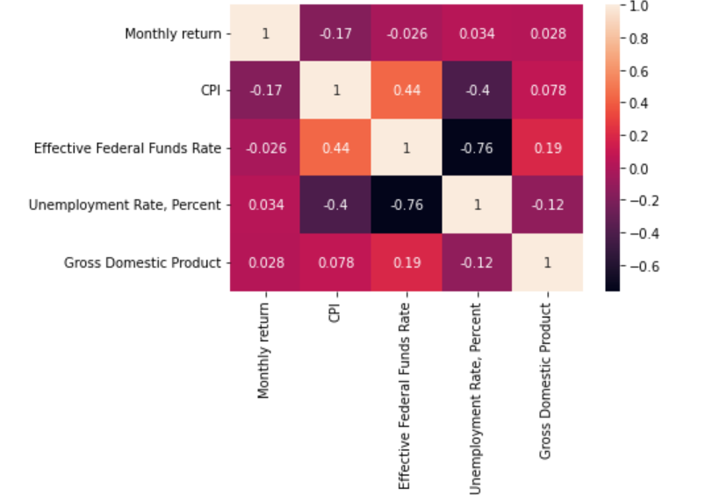
Dataset cleaning & Descriptive statistics
1. Convert Nadaq price into Monthly return
2. The dataset has been analysed using mean, variance, max & min to check for outliers
3. GDP & Interest rates are slightly correlated to Monthly return while CPI & Unemployment not

Slide 5
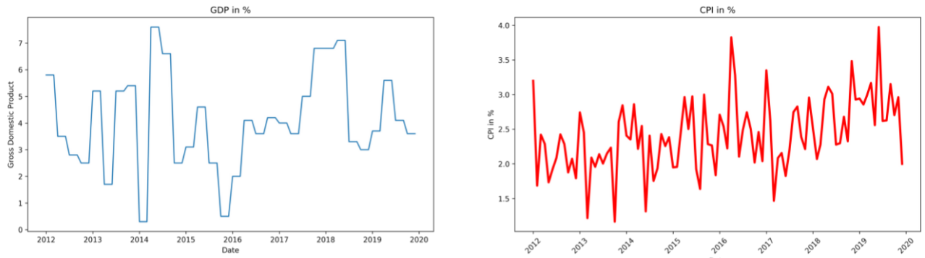
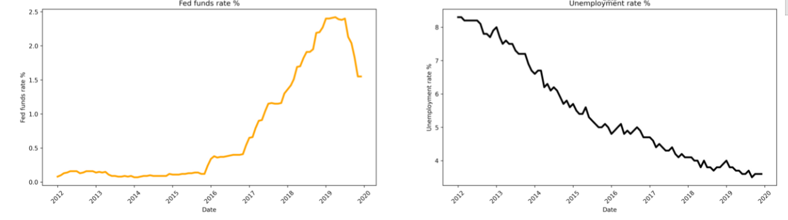
Independent variables - charts

Slide 6
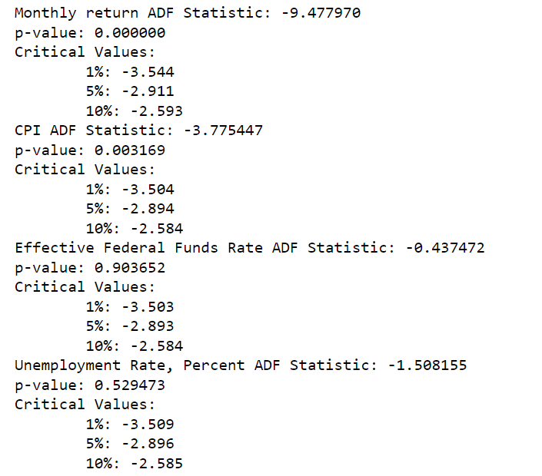
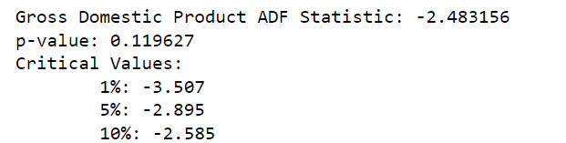
Test for stationarity
When dealing with time series data, it is important to examine the existence of unit root in the data series. We tested for stationarity using the Augmented Dickey-Fuller test.
We did log transform the dataset to make the distribution of values more linear
The results suggests we can that we can reject the null hypothesis for the CPI. Unit root is present for Fund rate, Unemployment and GDP
We used first-difference to make the series stationary

Slide 7
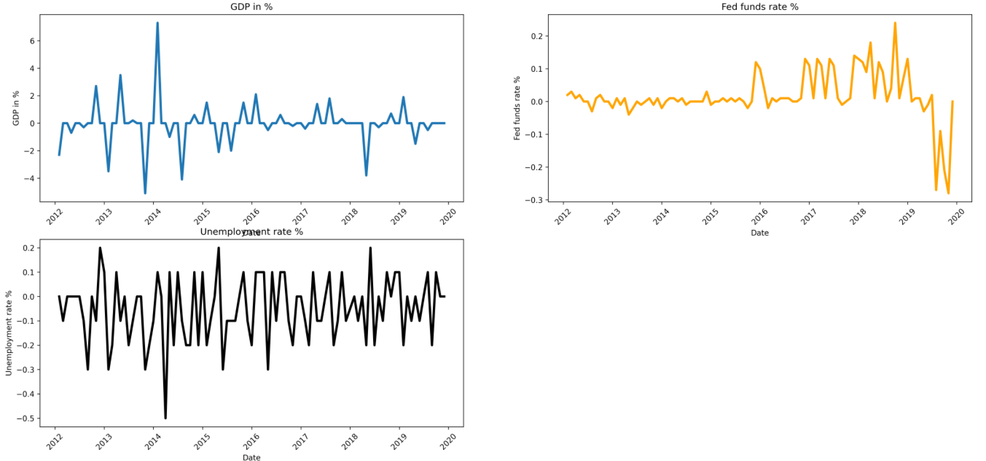
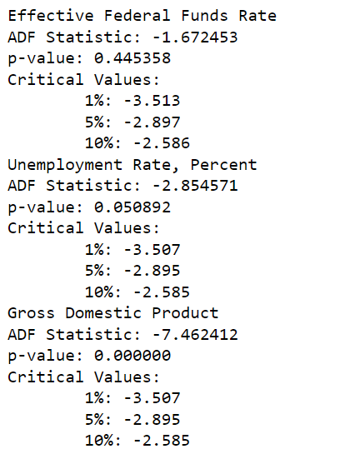
Test for stationarity – first difference

Slide 8
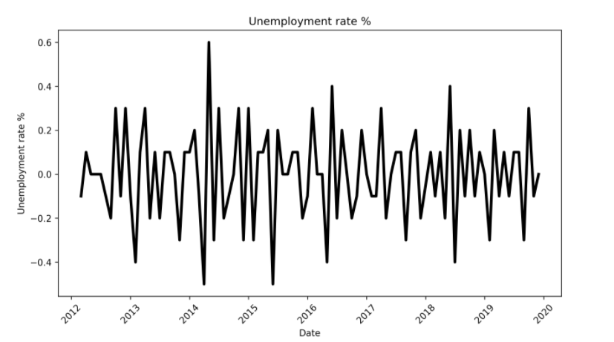
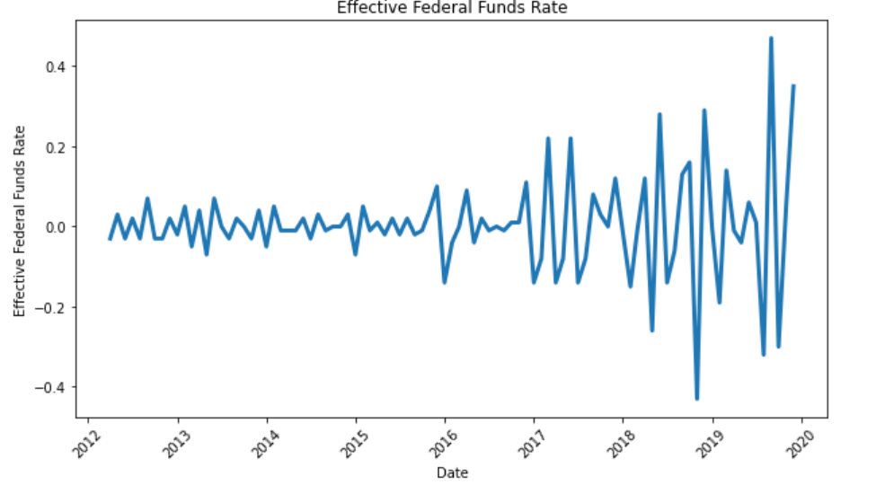
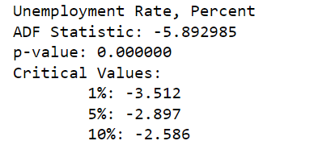
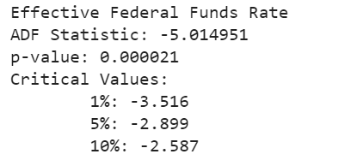
Test for stationarity – Second/Third difference

Slide 9
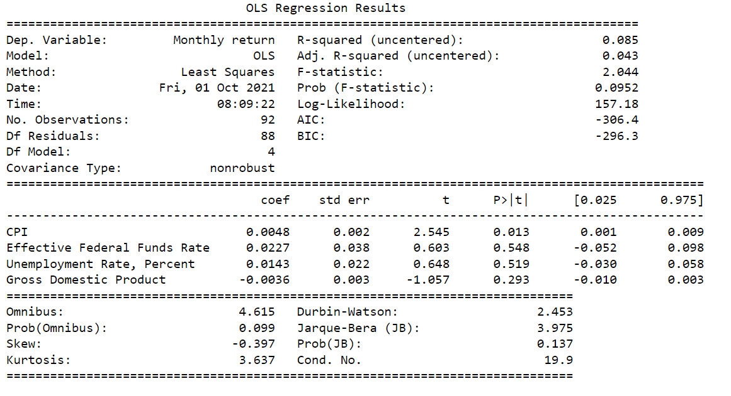
OLS regression results
-To analyze the relationship between the variables and the Nasdaq we run a linear regression (OLS).
Next steps: Include a lag, new macro variables, transform the independent variables (log, ect), PCA

Slide 10
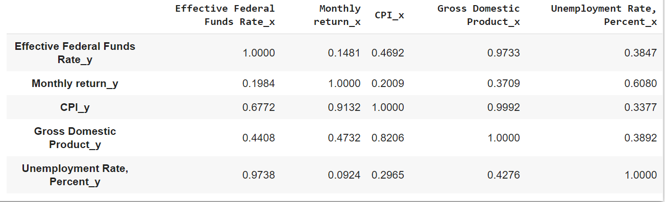
Appendix 1: Granger causality test

